Slide 1
Library always full and unable to Find any Private Space for Studying ? Don’t Worry, We got you

Slide 2
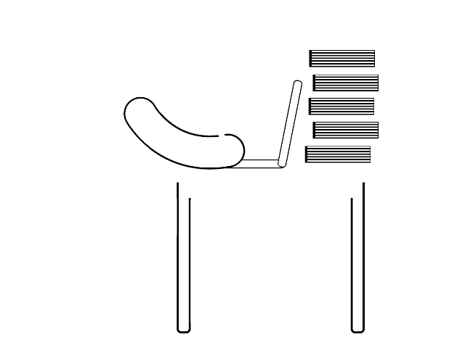
Study Spaces Booking WebApp

Slide 3




Presented By
Group- Mavericks
Altaf S. Shaikh
Aziz M. Vohra
Bhawna Bassarmalani
Satyajit Das
002774748
002743485
002925424
002991609

Slide 4

Purpose
A lot of times student often want to access study spaces for personal work or group work, but most of times they find their own college study room often booked. To resolve this issue, for students across Boston we have found and curated a list of study spaces which students can book at a very nominal rate.

Slide 5

Features
Login and register functionality
CRUD operations on the Booking application
Search and Filter functionality for location booking.
JWT Authentication and Password Hashing
Ant Design Library for UI Components,
Manage Tickets and User from the Admin Pane.
Authentication
Responsive UI design and Pagination.
User friendly and easy application.
Seats Availability Checking.
Location viewing on Map.
Stripe Payment Gateway Integration.
Handling negative payment scenarios.
Ticket saving in pdf format and QR code functionality.

Slide 6
Login - Authorization, Authentication
Booking Page functionalites- Bookings, checkout, confirmation, PDF print
Altaf
Users Profile & its functionalities
QR Code Functionality
Payment Gateway Integration
Aziz
Contributions
Everyone Contributed to implement UI design
Adding Study Space Form and space details
Managing the CRUD API’s and booking space API’s.
Bhawna
UI – Login, Registration, Booking
Map API
Satyajit

Slide 7







Tech Stack
STRIPE Google Maps API
mongoose
Axios, ANTD, Framer Motion
BcryptJS

Slide 8
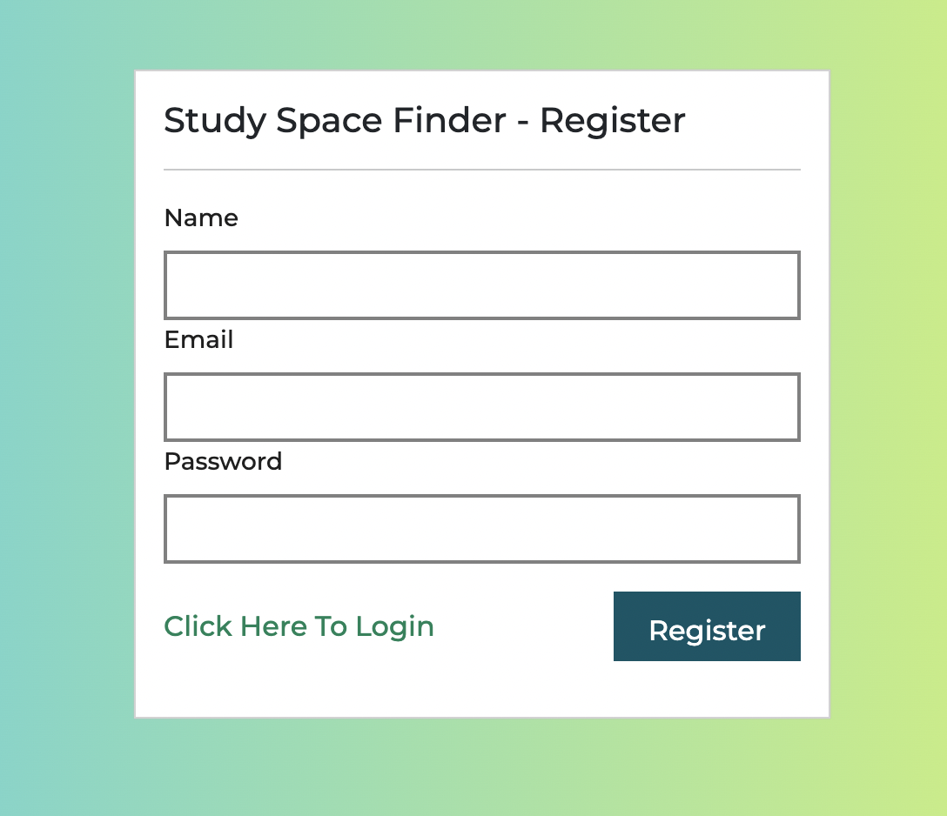
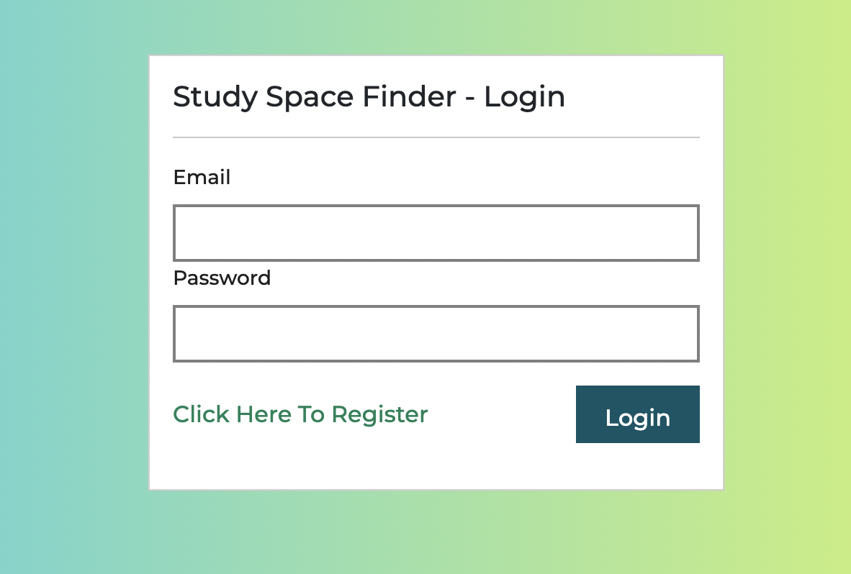
Website Snips
1. Register & Login Page

Slide 9
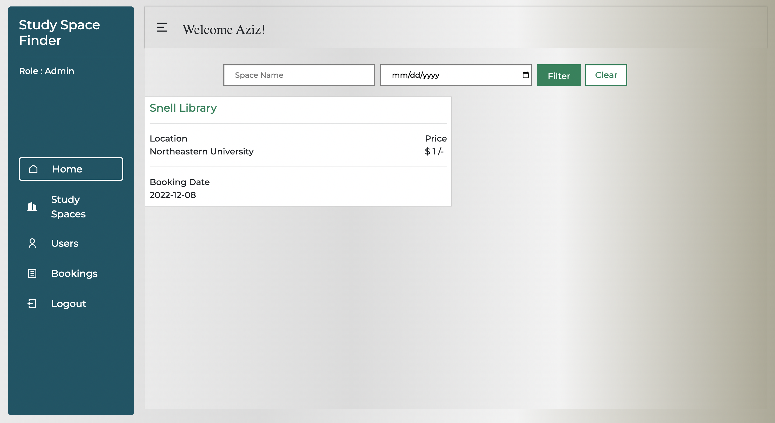
Admin HomePage

Slide 10
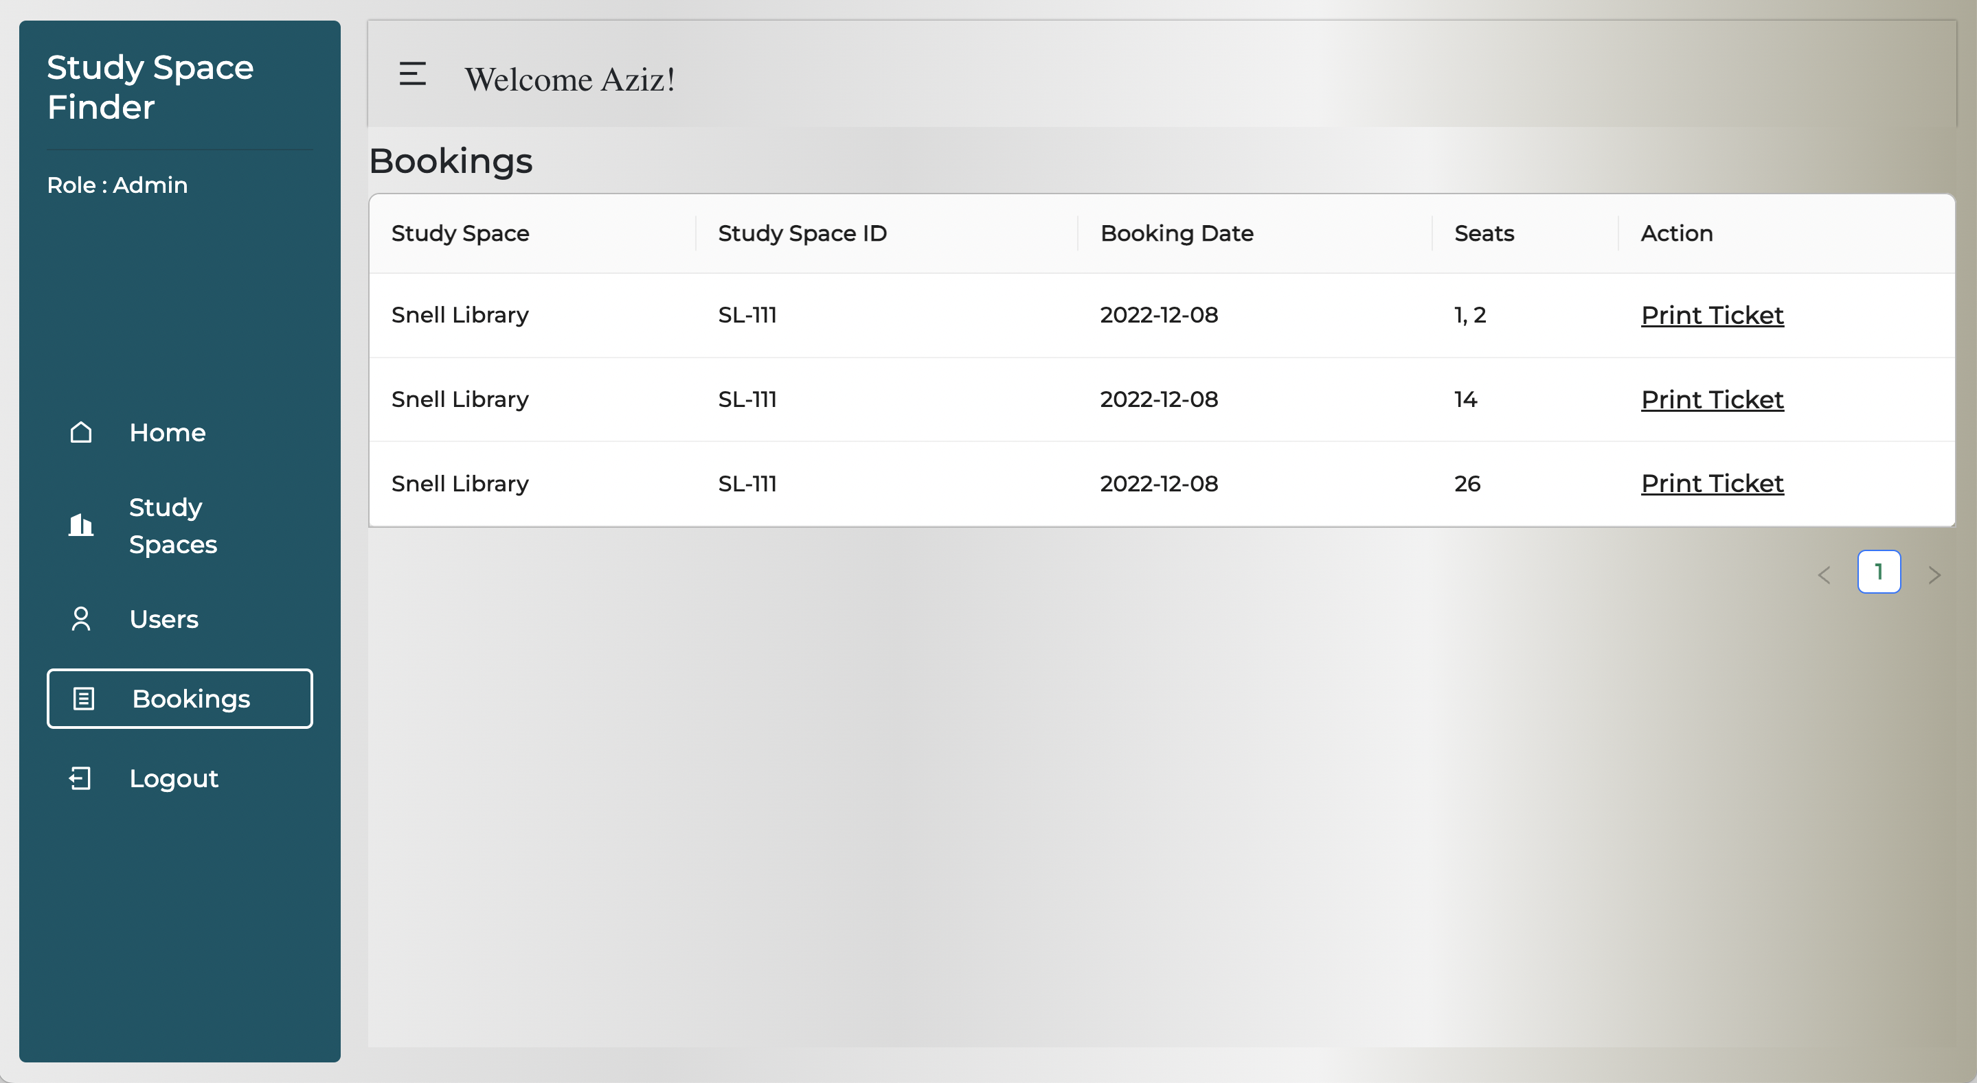
Admin Bookings Page

Slide 11
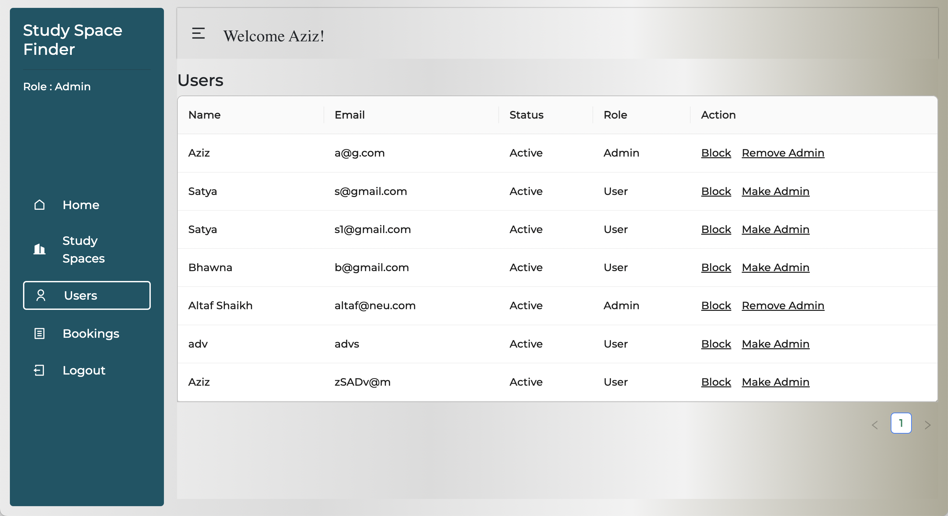
Admin: User Access Controls

Slide 12
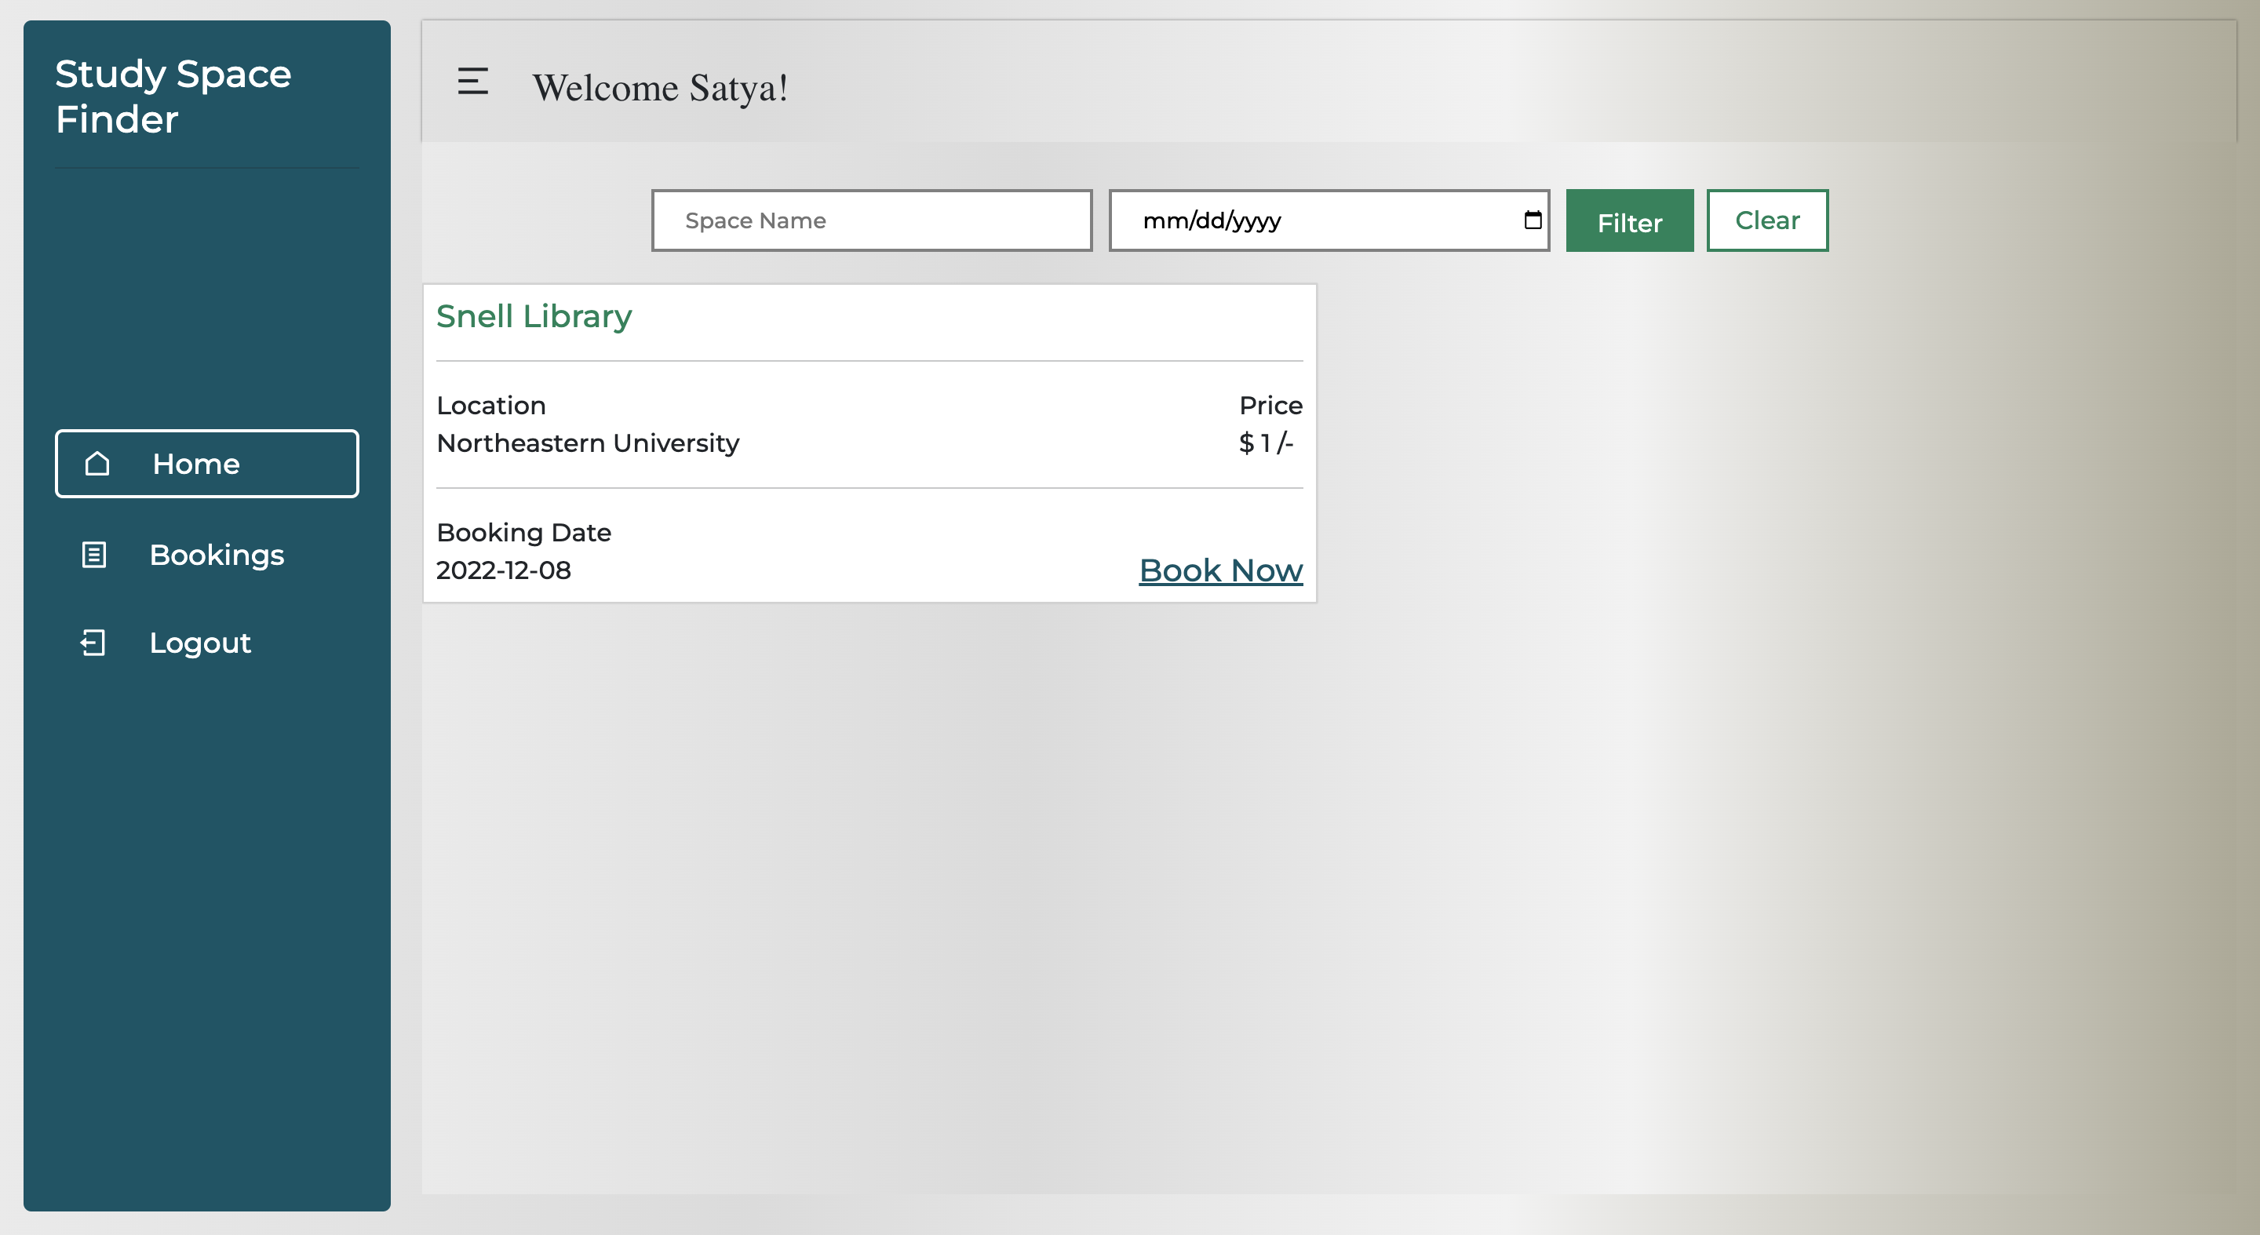
User Home Page

Slide 13
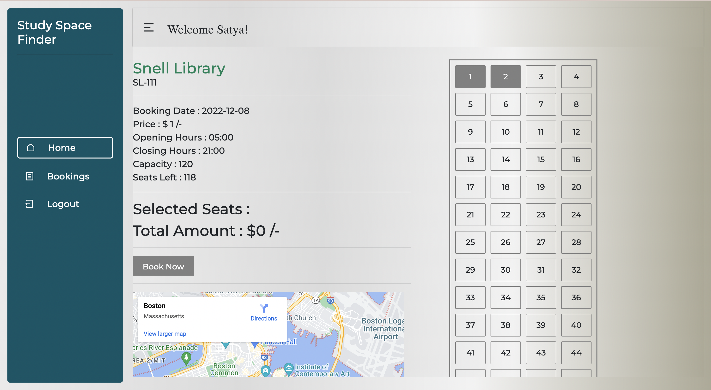
User Space Selection

Slide 14
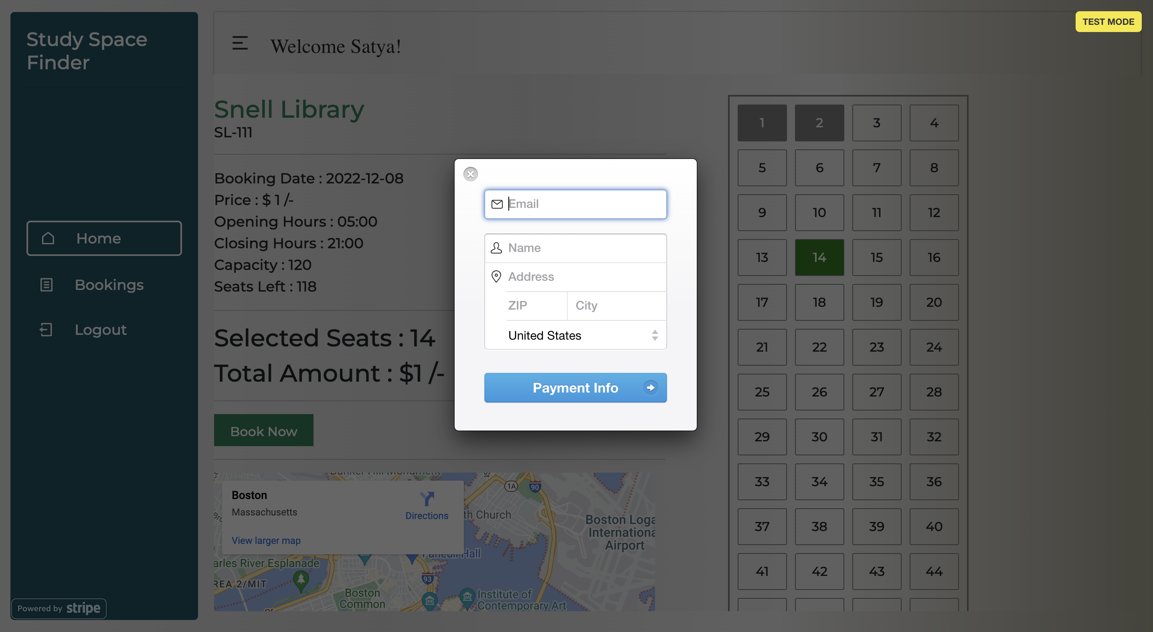
User Payment Page

Slide 15
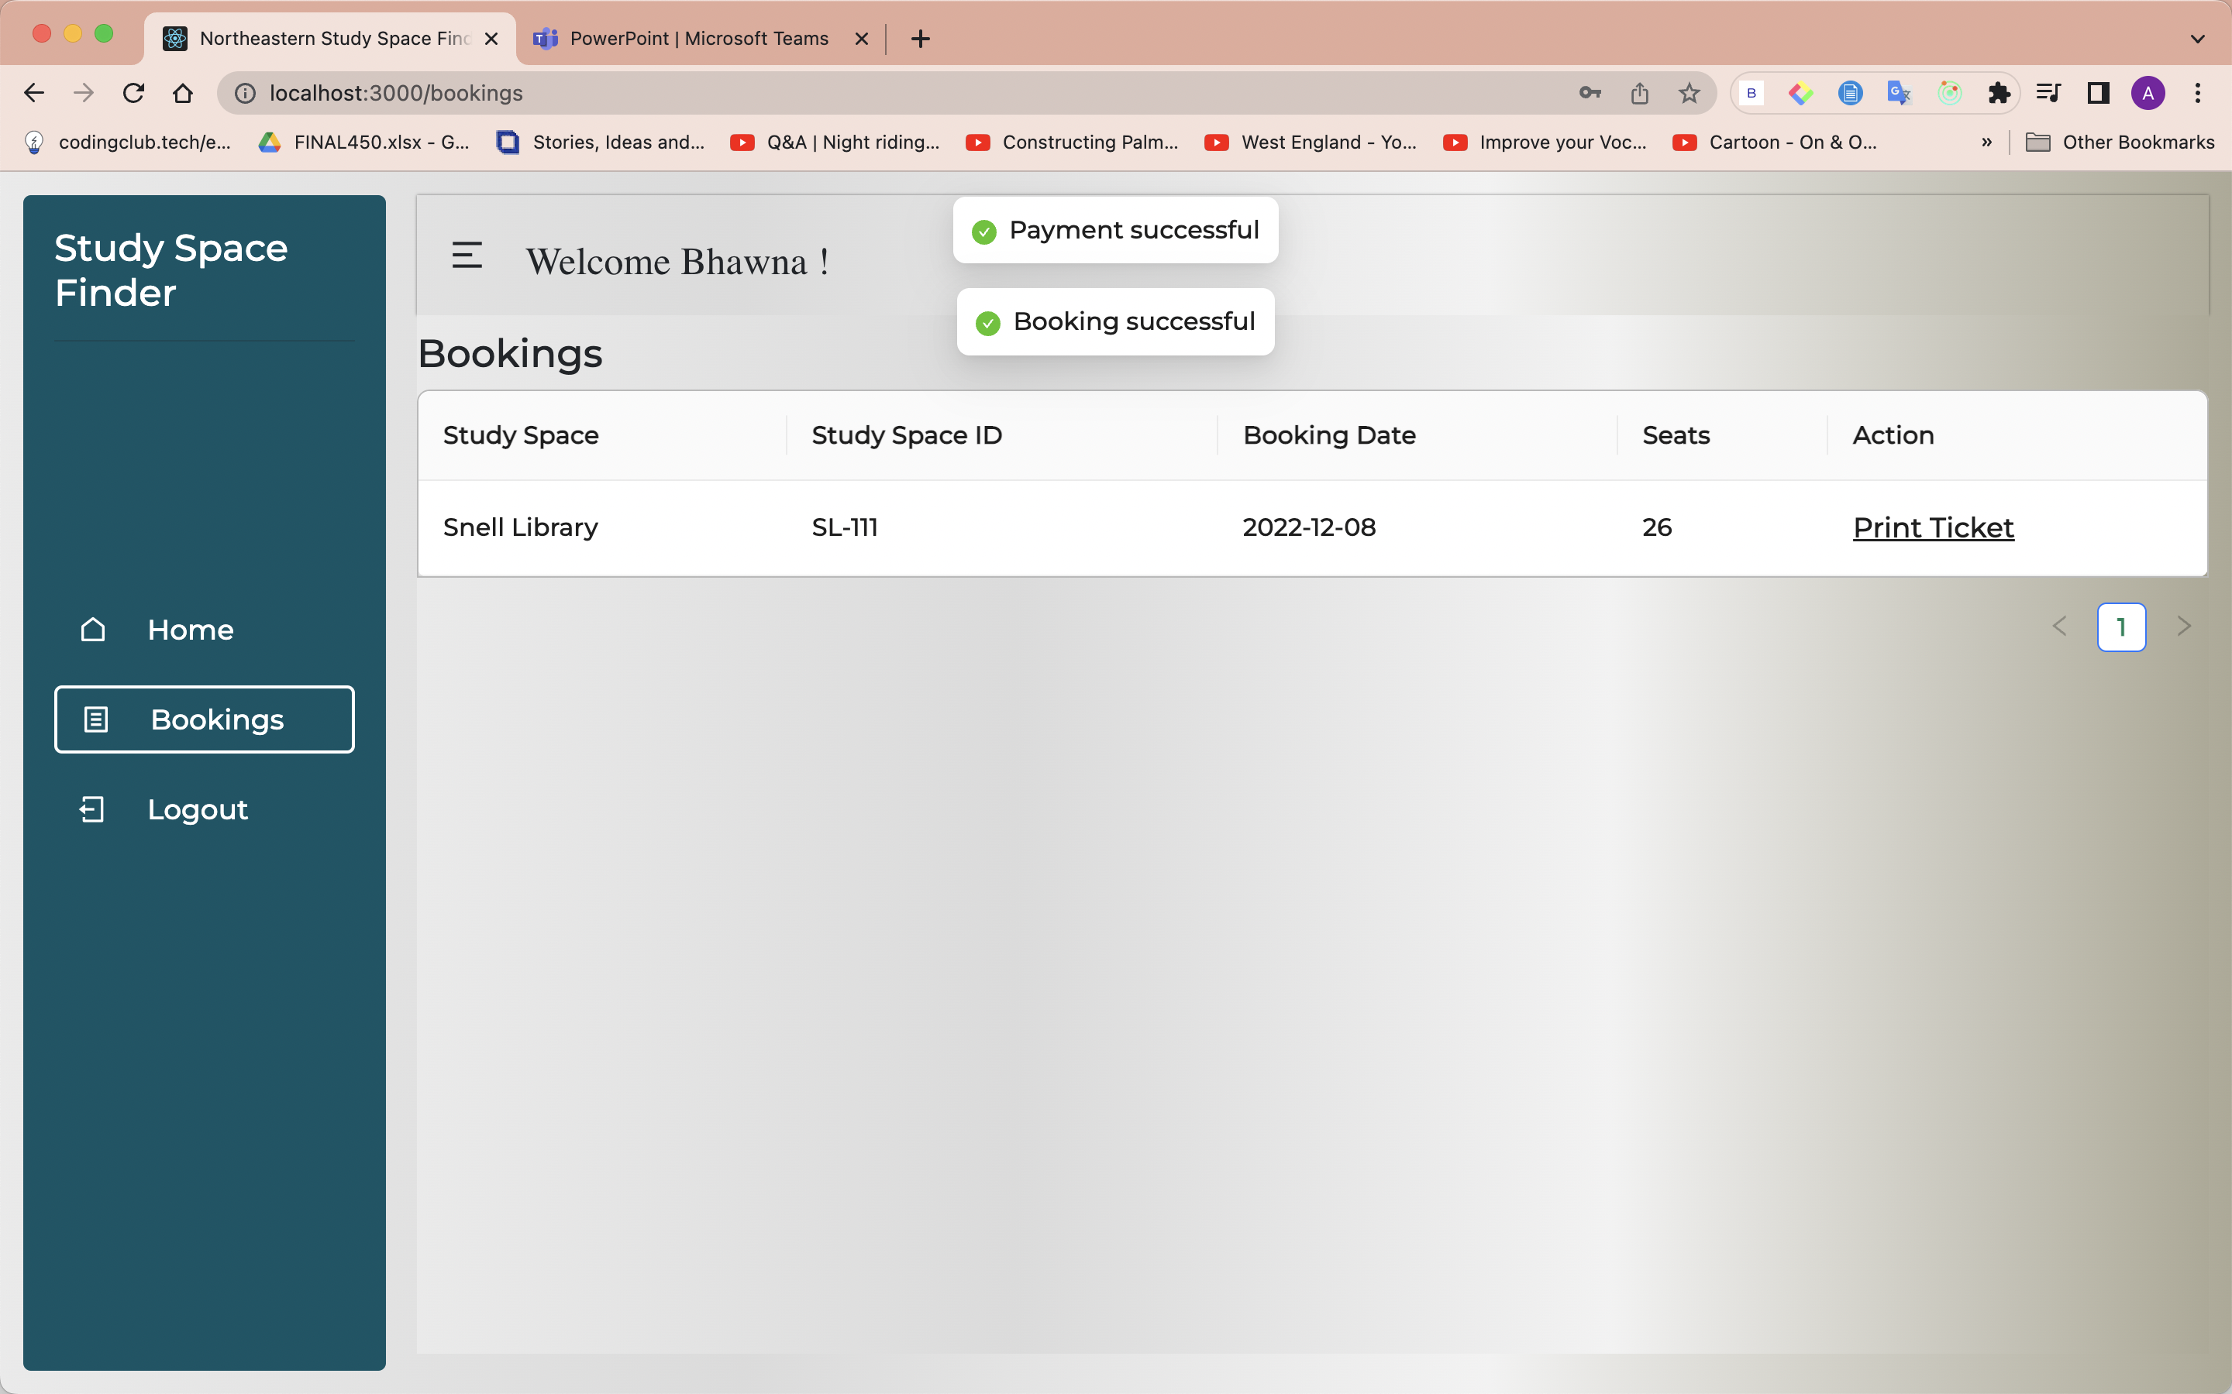
Space Confirmation

Slide 16
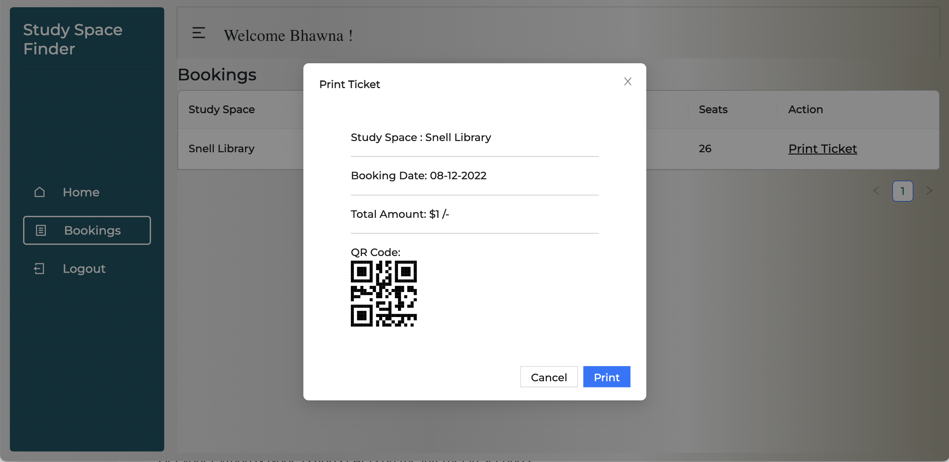
Print Ticket Modal

Slide 17
THANKS

